Slide 1




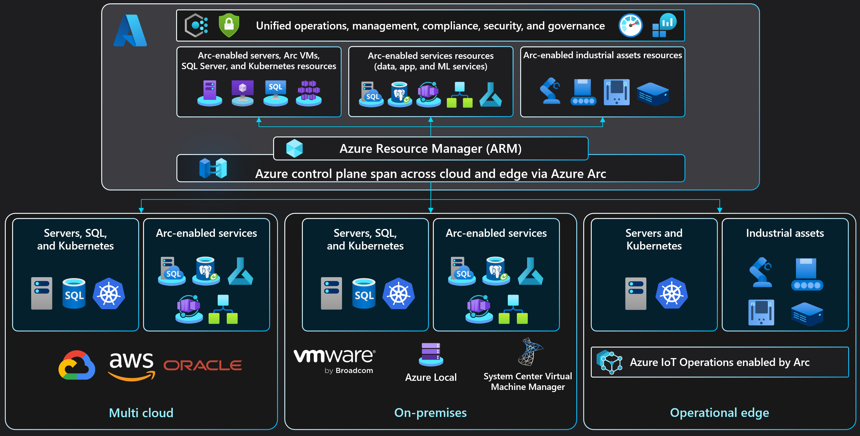


























SQL Server enabled by Azure Arc
Azure Arc solution architecture
Solution architecture
Security workflow architecture
SQL assets
Arc SQL extension
Microsoft Entra Identity (User Account / Service Principal)
Arc SQL Logs and Metrics flows continuously.
Inventory information is generated ~per hour.
Mandatory endpoints on Microsoft infrastructure
Deployer (short lived)
Enterprise Firewall and Proxy (Outbound only via port 443)
Private cloud environment
HTTPS/443
Arc-enabled data services endpoints *.<region>.arcdataservices.com
Windows Least Privilege
Service
(long running)
Portal / Azure CLI / REST API
Data
1
Arc-enabled server connectivity
HTTPS/443
Arc-enabled server endpoints
Control plane
Operating system firewall
Enterprise Proxy
TLS 1.2+
Corp firewall
Optional integration endpoints (features) on user-owned infrastructure
SQL Server enabled by Azure Arc features manage SQL assets via the extension on various levels
(Server / Host / Instance / Database / Availability Group)
Azure Resource Manager (ARM)
SQL Server
Azure Arc Connected Machine Agent
SQL Server enabled by Azure Arc Instance / Database / Availability Group configuration
1
Microsoft Entra ID integration
Hybrid Connections
Microsoft.AzureArcData
resource provider
SQL Server service
Arc SQL extension
Azure Monitor Agent (AMA) extension
2
HTTPS/443
Azure Key Vault
Windows Least Privilege
Data
Certificate for Microsoft Entra ID configuration (Optional)
SQL Server
Arc Guestconfig service
Microsoft.HybridCompute
resource provider
Arc-enabled server configuration
SQL Best Practices Assessment
SQL assets
Azure Arc Connected Machine Agent
2
HTTPS/443
Log Analytics workspace
Best Practices Assessment results (Optional)
Data plane *.<region>.arcdataservices.com
2
Microsoft Defender for Cloud
Data Processing service (DPS) Inventory / Billing / Licenses
Telemetry service Logs / Metrics / migration assessments
Microsoft Defender for Cloud posture results (Optional)
HTTPS/443
Log Analytics workspace
3
Additional features integration
Additional SQL Server enabled by Azure Arc integrations (Optional)
SQL Best Practices Assessment (BPA) architecture
Failover Cluster Instance (FCI) architecture
Availability Groups (AG) architecture
Arc-enabled SQL Server A
FCI 1 (active)
network_name\instance1
FCI-1 assets
Arc-enabled SQL Server B
FCI 2 (active)
network_name\instance2
FCI-2 assets
Arc-enabled SQL Server C
FCI 1 (passive)
Arc-enabled SQL Server A
SQL AG1 (primary replica)
AG1 databases
Manual failover
Arc-enabled SQL Server B
SQL AG1 (secondary replica)
AG1 databases
Manual failover
Arc-enabled SQL Server C
SQL AG1 (secondary replica)
AG1 databases
Manual failover
Private cloud environment
FCI 2 (passive)
FCI 1 (passive)
FCI 2 (passive)
AG2 databases
Health status
AG2 databases
Health status
Health status
Data
SQL AG2 (secondary replica)
Health status
SQL AG2 (primary replica)
Health status
SQL AG2 (secondary replica)
AG2 databases
Health status
Arc-enabled server A
Arc-enabled server B
Arc-enabled server C
Manual failover
Manual failover
Manual failover
SQL Server
Operating system firewall
Enterprise Firewall and Proxy (Outbound only via port 443)
Arc-enabled server A
Arc-enabled server B
Arc-enabled server C
Transmits report to Log Analytics workspace
Enterprise Proxy
TLS 1.2+
Corp firewall
SQL Best Practices Assessment
Enterprise Firewall and Proxy (Outbound only via port 443)
3
BPA report user interface
User-owned environment (On-premises and Multicloud)
1
Runs SQL Assessment and generates report
Sends report to AMA
2
Windows Server Failover Cluster (WSFC)
User-owned environment (On-premises and Multicloud)
network_name\instance1
network_name\instance2
Windows Server Failover Cluster (WSFC)
SQL Server service
Arc SQL extension
Azure Monitor Agent (AMA) extension
Data
SQL Server A
SQL Server B
SQL Server C
AG1 listener1 / AG2 listener2
Windows Least Privilege
4
Retrieve and display BPA results
Arc SQL extension
Arc SQL extension
Arc SQL extension
SQL Server A
SQL Server B
SQL Server C
Azure Arc Connected Machine Agent
Azure Arc Connected Machine Agent
Azure Arc Connected Machine Agent
Arc SQL extension
Arc SQL extension
Arc SQL extension
Data
Log Analytics workspace
SQL Server service (Instance1, active)
SQL Server service (Instance2, passive)
SQL Server service (Instance1, passive)
SQL Server service (Instance2, active)
SQL Server service (Instance1, passive)
SQL Server service (Instance2, passive)
Azure Arc Connected Machine Agent
Azure Arc Connected Machine Agent
Azure Arc Connected Machine Agent
SQL assets
Azure Arc Connected Machine Agent
HTTPS/443
SQL AG1 (primary replica)
SQL AG2 (secondary replica)
SQL AG1 (secondary replica)
SQL AG2 (primary replica)
SQL AG1 (secondary replica)
SQL AG2 (secondary replica)
active
active
Cluster shared storage
Instance1 shared storage
Instance2 shared storage
local storage
local storage
local storage
Copyright @ 2025 Microsoft. All rights reserved. v1.3 #ArcJumpstart | aka.ms/JumpstartGems

